Slide 1
ASP.NET MVC
Lecturer: Ngo Huy Bien
Software Engineering Department
Faculty of Information Technology
VNUHCM - University of Science
Ho Chi Minh City, Vietnam
nhbien@fit.hcmus.edu.vn

Slide 2

Objectives
To create ASP.NET MVC application

Slide 3

References
Adam Freeman. Pro ASP.NET MVC 5. 2013.
Dino Esposito (2014). Programming Microsoft ASP.NET MVC. Microsoft Press.
Jon Galloway et al. Professional ASP.NET MVC 5. 2014.

Slide 4

Warming Up

Slide 5
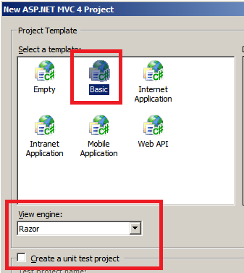
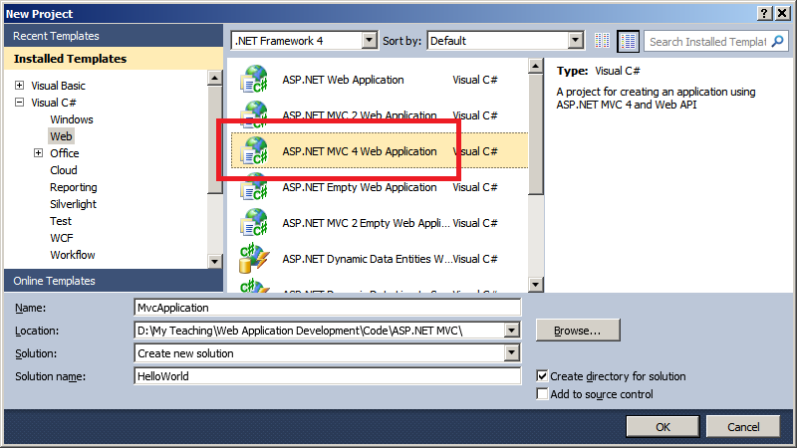
Creating a Web Application

Slide 6
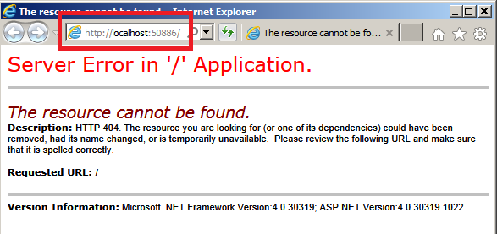
A Web Application Output

Slide 7
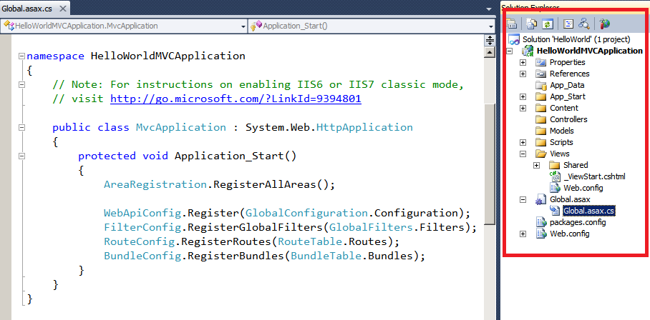
Physical Structure

Slide 8

Global.asax.cs: The Main Entry
public class MvcApplication : System.Web.HttpApplication
{
protected void Application_Start()
{
AreaRegistration.RegisterAllAreas();
WebApiConfig.Register(GlobalConfiguration.Configuration);
FilterConfig.RegisterGlobalFilters(GlobalFilters.Filters);
RouteConfig.RegisterRoutes(RouteTable.Routes);
BundleConfig.RegisterBundles(BundleTable.Bundles);
}
}

Slide 9
App_Start/FilterConfig.cs
public class FilterConfig
{
public static void RegisterGlobalFilters(GlobalFilterCollection filters)
{
filters.Add(new HandleErrorAttribute());
}
}

Slide 10
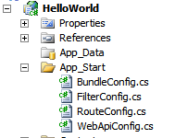
App_Start/RouteConfig.cs
public class RouteConfig
{
public static void RegisterRoutes(RouteCollection routes)
{
routes.IgnoreRoute("{resource}.axd/{*pathInfo}");
routes.MapRoute(
name: "Default",
url: "{controller}/{action}/{id}",
defaults: new { controller = "Home", action = "Index", id = UrlParameter.Optional }
);
}
}

Slide 11
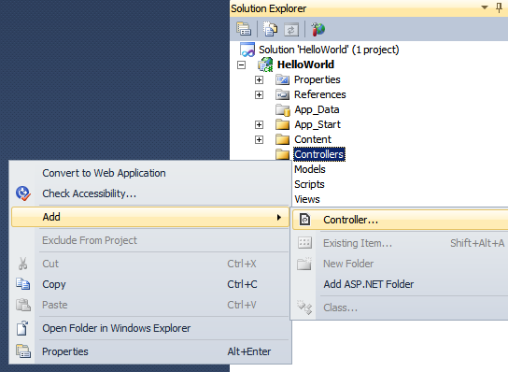
Controller: Your Code Here
namespace HelloWorld.Controllers
{
public class HomeController : Controller
{
// GET: /Home/
public ActionResult Index()
{
return View();
}
}
}

Slide 12
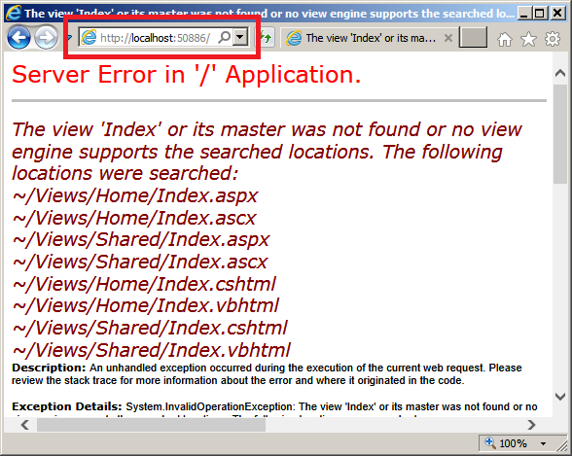
A Web Application Output

Slide 13
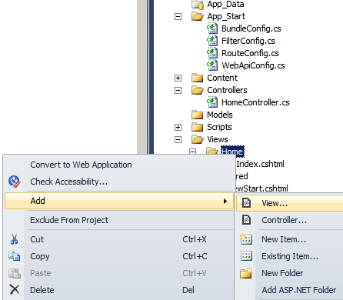

View: Output Here
@{
Layout = null;
}
<!DOCTYPE html>
<html>
<head>
<meta name="viewport" content="width=device-width" />
<title>Index</title>
</head>
<body>
<div>
Hello World!
</div>
</body>
</html>

Slide 14


Slide 15
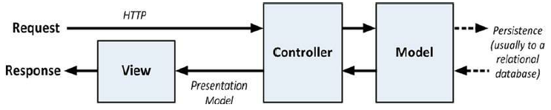
How MVC Works [1]
Controllers are C# classes, usually derived from the System.Web.Mvc.Controller class.
Each public method in a class derived from Controller is an action method, which is associated with a configurable URL through the ASP.NET routing system.
When a request is sent to the URL associated with an action method, the statements in the controller class are executed in order to perform some operation on the domain model and then select a view to display to the client.

Slide 16
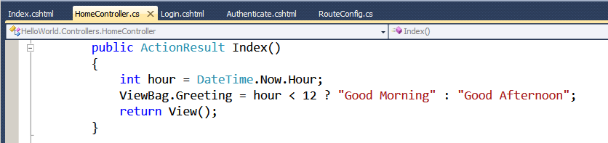
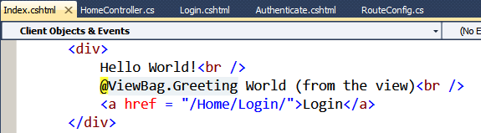
Passing Data From Controller To View
One way to pass data from the controller to the view is by using the ViewBag object, which is a member of the Controller base class.
ViewBag is a dynamic object to which you can assign arbitrary properties, making those values available in whatever view is subsequently rendered.

Slide 17
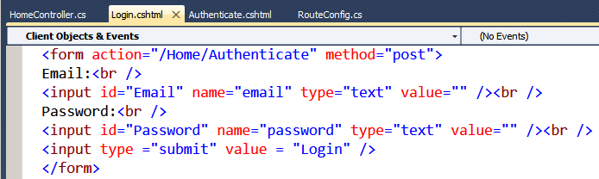
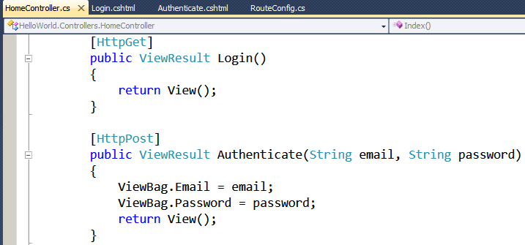
Passing Data From View To Controller

Slide 18
Advantages of ASP.NET MVC
Multiple forms
Similar to other established, non-Microsoft frameworks
Adheres to the "stateless" nature of the web
Test driven development
Separation of concern

Slide 19
Disadvantages of ASP.NET MVC
HTML & CSS skills must be resurrected
Learning curve

Slide 20
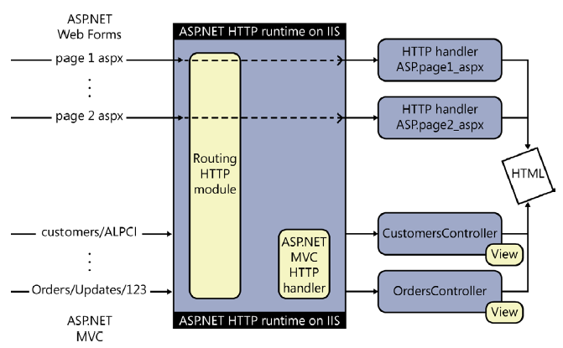
Routing the Requests [2]
What happens exactly when a request knocks at the Internet Information Services (IIS) gate?

Slide 21
Application Routes
A route is a pattern-matching string that represents the absolute path of a URL—namely, the URL string without protocol, server, and port information.
/{resource}/{action}
/Customer/{action}
/home/test
Here’s the default route for an ASP.NET MVC application:
{controller}/{action}/{id}

Slide 22
Defining Application Routes
Routes for an application are usually registered in the global.asax file, and they are processed at the application startup.
public class MvcApplication : HttpApplication{
protected void Application_Start(){
RouteConfig.RegisterRoutes(RouteTable.Routes);
// Other code
...
}
}
public class RouteConfig{
public static void RegisterRoutes(RouteCollection routes){
// Other code
...
// Listing routes
routes.MapRoute("Default","{controller}/{action}/{id}",
new { controller = "Home“, action = "Index", id = UrlParameter.Optional
});
}
}

Slide 24
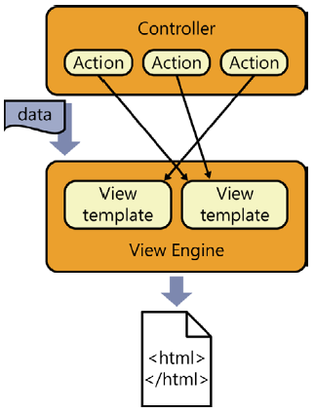
Controllers and View Engine [2]

Slide 25
View Engine
In ASP.NET MVC, a view engine is merely a class that implements a fixed interface—the IViewEngine interface.
Each application can have one or more view engines.
In ASP.NET MVC 5, each application comes by default with two view engines: Razor and ASPX.

Slide 26
ViewEngines Class
The ViewEngines class is the system repository that tracks the currently installed engines.
The class is simple and exposes only a static collection member named Engines.
public static class ViewEngines {
private static readonly ViewEngineCollection _engines =
new ViewEngineCollection {
new WebFormViewEngine(), new RazorViewEngine()
};
public static ViewEngineCollection Engines {
get { return _engines; }
}
...
}

Slide 27
Anatomy of a View Engine
A view engine is a class that implements the IViewEngine interface.
public interface IViewEngine{
ViewEngineResult FindPartialView(
ControllerContext controllerContext,
String partialViewName, Boolean useCache);
ViewEngineResult FindView(
ControllerContext controllerContext,
String viewName, String masterName, Boolean useCache);
void ReleaseView(
ControllerContext controllerContext,
IView view);
}

Slide 28
ViewEngineResult Class
Both FindPartialView and FindView return a ViewEngineResult object, which represents the results of locating a template for the view around the server directory tree and instantiating it.
The ViewEngineResult type just aggregates three elements: the view object, the view engine object used to create it, and the list of locations searched to find the template of the view.
public class ViewEngineResult
{
...
// Members
public IEnumerable<String> SearchedLocations { get; private set; }
public IView View { get; private set; }
public IViewEngine ViewEngine { get; private set; }
}

Slide 29
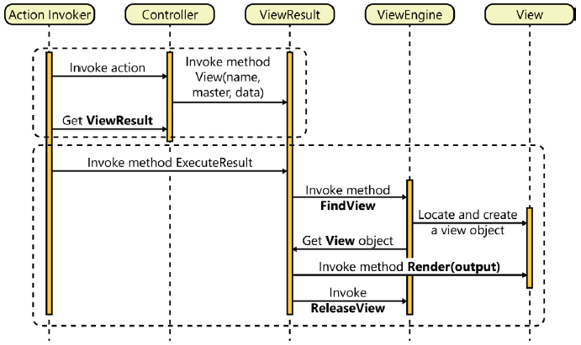
Who calls the View Engine?

Slide 30
View Object
The view object is an instance of a class that implements the IView interface.
The only purpose of a view object is for writing some HTML response to a text writer.
Each view is identified by name.
The name of the view is also associated with some physical file that defines the HTML layout to render.
Resolving the association between the view name and actual HTML layout is the responsibility of the view engine.
public interface IView
{
void Render(ViewContext viewContext, TextWriter writer);
}

Slide 31
View Template
Everything being displayed to the user results from a view and is described in terms of a template file.
The graphical layout is then transformed into HTML and styled via one or more cascading style sheet (CSS) files.
The way in which the template file is written, however, depends on the view engine.
Each view engine has its own markup language to define the template, and its own set of rules to resolve a view name into a template file.

Slide 32
ASPX View Template
<%@ Page Language="C# » MasterPageFile="~/Views/Shared/Site.Master"
Inherits="System.Web.Mvc.ViewPage" %>
<asp:Content ID="aboutTitle" ContentPlaceHolderID="TitleContent" runat="server">
About the book
</asp:Content>
<asp:Content ID="aboutContent" ContentPlaceHolderID="MainContent" runat="server">
<h2><%: ViewBag.Message %></h2>
<p>
Put content here.
</p>
</asp:Content>

Slide 33
Coresponding Controller Method
public ActionResult About()
{
ViewBag.Message = "Thank you for choosing this book!";
// By default, the view name is the same as the action name.
return View();
}

Slide 34
HTML Helpers
<% using (Html.BeginForm()) { %>
<div>
<fieldset>
<legend>Account Information</legend>
<p>
<label for="userName">User name:</label>
<%= Html.TextBox("userName") %>
<%= Html.ValidationMessage("userName") %>
</p>
<p>
<label for="password">Password:</label>
<%= Html.Password("password") %>
<%= Html.ValidationMessage("password") %>
</p>
...
<p>
<input type="submit" value="Change Password" />
</p>
</fieldset>
</div>
<% } %>

Slide 35
Partial Views
You use either the Partial or RenderPartial helper method to insert a partial view.
The only difference between the two is that Partial returns a string, whereas RenderPartial writes to the output stream and returns void.
@Html.Partial("login")
@Html.RenderPartial("login")

Slide 36
ASPX View Engine Problem
The ASPX markup was devised as a way to support server controls, and it has severe limitations when used mostly with code blocks.
Clearly, the major issue is lack of readability.

Slide 37
Razor View Template
<html>
<head>
<title>@ViewBag.Title</title>
<link href="@Url.Content("~/Content/Site.css")" rel="stylesheet" type="text/css" />
<script src="@Url.Content("~/Scripts/jquery.js")" type="text/javascript"></script>
</head>
...
</html>

Slide 39
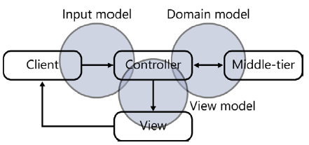
Input Processing in ASP.NET MVC
The input model provides the representation of the data being posted to the controller.
The view model provides the representation of the data being worked on in the view.
The domain model is the representation of the domain-specific entities operating in the middle tier.
Note that the three models are not neatly separated.
You might find overlap between the models.
This means that classes in the domain model might be used in the view, and classes posted from the client might be used in the view.
The final structure and diagram of classes is up to you.

Slide 40
The Input Model
To pass input data to a controller, you need to package data in some way.
The input model refers to the model through which posted data is exposed to controllers and subsequently received by the application.
The input model defines the DTOs the application uses to receive data from input forms.
public class BindingController : Controller{
// http://server/binding/repeat?text=Dino&number=2
public ActionResult Repeat(String text, Int32 number){
var model = new RepeatViewModel {Number = number, Text = text};
return View(model);
}
}

Slide 41
Working with the Model Object [1]
...
@model Razor.Models.Product
...
Razor statements start with the @ character.
In this case, the @model statement declares the type of the model object that I will pass to the view from the action method.
This allows me to refer to the methods, fields, and properties of the view model object through @Model.

Slide 42
Applying a Layout
<!DOCTYPE html> //the _BasicLayout.cshtml File
<html>
<head>
<meta name="viewport" content="width=device-width" />
<title>@ViewBag.Title</title></head>
<body>
<h1>Product Information</h1>
<div style="padding: 20px; border: solid medium black; font-size: 20pt">
@RenderBody()
</div>
<h2>Visit <a href="http://apress.com">Apress</a></h2></body>
</html>
@model Razor.Models.Product
@{ ViewBag.Title = "Product Name";
Layout = "∼/Views/_BasicLayout.cshtml";}
Product Name: @Model.Name // The call to the @RenderBody method inserts the contents of the view specified by the action method into the layout markup.

Slide 43
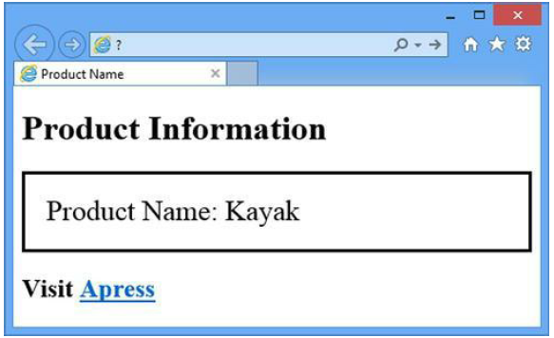
Result

Slide 45
Modeling the View
Using Razor (or the ASPX engine), you define the graphical layout of a view.
Sometimes, the view is just made of static content.
More often, though, the view must incorporate real data resulting from some operation against the middle tier of the system or loaded from the application cache or session state.
How would you make this data available to the view?

Slide 46
The ViewData Dictionary
Exposed directly by the Controller class, the ViewData property is a name-value dictionary object.
Keep in mind that you are not limited to storing strings in the ViewData dictionary.
public ActionResult Index()
{
ViewData["PageTitle"] = "Programming ASP.NET MVC";
return View();
}
<head>
<title> @ViewData["PageTitle"] </title>
</head>

Slide 47
The ViewBag Dictionary
Also defined on the Controller class, the ViewBag property offers an even more flexible facility to pass data to the view.
The property is defined as a dynamic type, as illustrated here:
public dynamic ViewBag { get; }
public ActionResult Index() {
// Using ViewData
ViewData["PageTitle"] = "Programming ASP.NET MVC";
// Using ViewBag
ViewBag.PageTitle = "Programming ASP.NET MVC";
//The compiler doesn’t care whether a property named PageTitle really exists on ViewBag.
return View();
}
<head>
<title> @ViewBag.PageTitle </title>
</head>

Slide 48
Strongly Typed View Models
public ActionResult Index()
{
...
// Pack data for the view using a view-specific container object.
var model = new LatestOrderViewModel();
// Populate the model.
...
// Trigger the view.
return View(model);
}
public class LatestOrderViewModel
{
public DateTime OrderDate { get; set; }
public String Status { get; set; }
}

Slide 49
Using View Model Object
When you use a view model object, you must declare the view model type in the view template so that the actual view object can be created of type ViewPage<T> in the ASPX view engine and of type WebViewPage<T> if Razor is used.
<%@ Page Language="C#" MasterPageFile="~/Views/Shared/Site.Master"
Inherits="System.Web.Mvc.ViewPage<LatestOrderViewModel>" %>
@model LatestOrderViewModel
<h2>
Latest order placed
<span class="highlight">@Model.OrderDate.ToString("dddd, dd MMM yyyy")</span>
<br />
Status is: <span class="highlight">@Model.Status</span>
</h2>

Slide 50
Passing a List
Suppose that you need to pass a list of orders to the view.
Functionally speaking, the approach is sound. But is it extensible? In my experience, you always end up stuffing a variety of heterogeneous data in a view.
A view-model class ultimately models the view, not the data.
@model IList<PendingOrder>
@model YourViewModel
public class YourViewModel
{
public IList<PendingOrder> PendingOrders {get; set;}
}

Slide 52
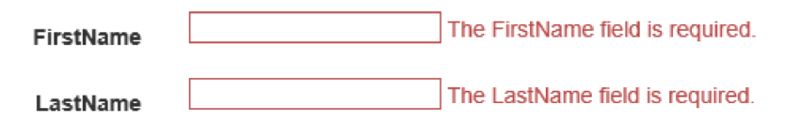
Validation Annotations [3]
Data annotations are attributes you can find in the System.ComponentModel.DataAnnotations namespace (although one attribute is defined outside this namespace, as you will see).
These attributes provide server-side validation, and the framework also supports client-side validation when you use one of the attributes on a model property.
[Required]
public string FirstName { get; set; }
[Required]
public string LastName { get; set; }

Slide 53
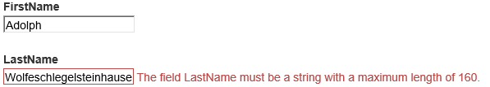
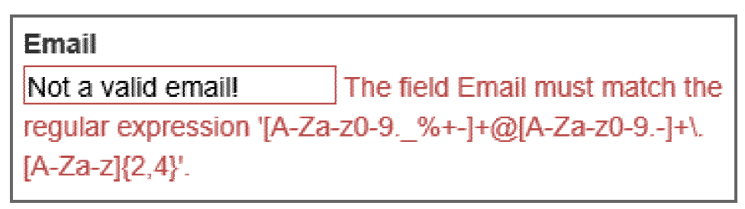
Example
[Required]
[StringLength(160)]
public string LastName { get; set; }
[RegularExpression(@"[A-Za-z0-9._%+-]+@[A-Za-z0-9.-]+\.[A-Za-z]{2,4}")]
public string Email { get; set; }

Slide 54
Validation and Model Binding
By default, the ASP.NET MVC framework executes validation logic during model binding.
The model binder runs implicitly when you have parameters to an action method.
[HttpPost]
public ActionResult Create(Album album)
{
// the album parameter was created via model binding
// ...
}

Slide 55
Validation and Model State
The primary side effect of model binding is model state (accessible in a Controller-derived object using the ModelState property).
Not only does model state contain all the values a user attempted to put into model properties, but model state also contains all the errors associated with each property (and any errors associated with the model object itself).
If any errors exist in model state, ModelState.IsValid returns false.
[HttpPost]
public ActionResult CreateOrder(Order newOrder)
{
if (ModelState.IsValid)
{
...

Slide 56
URL Helpers
The URL helpers build URLs and return the URLs as strings.
The Content helper is particularly helpful because it can convert a relative application path to an absolute application path.
<span>
@Url.Action("Browse", "Store", new { genre = "Jazz" }, null)
// Output: /Store/Browse?genre=Jazz
</span>
<script src="@Url.Content("~/Scripts/jquery-1.10.2.min.js")"
type="text/javascript"></script>

Slide 58
Cache Object
In ASP.NET, built-in caching capabilities come through the Cache object.
The Cache object is created on a per-AppDomain basis, and it remains valid while that AppDomain is up and running.
The object is unique in its capability to automatically scavenge the memory and get rid of unused items.
You can prioritize and associate cached items with various types of dependencies, such as disk files, other cached items, and database tables.
When any of these items change, the cached item is automatically invalidated and removed.
Aside from that, the Cache object provides the same familiar, dictionary-based programming interface as Session.
Unlike Session, however, the Cache object does not store data on a per-user basis.

Slide 59
Using the Cache Object
You should be accessing the Cache object preferably from a controller class or from infrastructure classes such as global.asax, as shown here:
protected void Application_Start()
{
var data = LoadFromSomeRepository();
Cache[CacheEntries.CustomerRecords] = data;
...
}
var customerRecords = new CustomerRecords();
var data = Cache[CacheEntries.CustomerRecords];
if (null != data)
customerRecords = (CustomerRecords) data;

Slide 60
In MVC, output caching allows you to store the output of controller actions and return these cached results instead of actually executing the controller actions on subsequent calls.

Slide 61
Caching the Method Response
[OutputCache(Duration=10, VaryByParam="None")]
public ActionResult Index()
{
...
}
The Duration parameter indicates how long (in seconds) the method’s response should stay cached in memory.
The VaryByParam attribute indicates how many distinct versions of the response you should cache, one for each distinct value of the specified property.
If you use None, you’re informing the system that you don’t want multiple versions of the same method’s response.

Slide 63
Controller/View Mechanics
http://devproconnections.com/development/how-use-aspnet-mvc-render-action-helpers
In ASP.NET MVC, the controller is the component that deals with the request details.
The controller reads the information from the request and decides the action to take.
The action produces data for the view.
Next, the controller selects the next view to render and passes data to incorporate.
The basic mechanics work very well as long as the view is a thin and humble object-no processing logic, just plain rendering and binding logic.

Slide 64
Complex View
But what if adjusting the data for the view requires some work?
What kind of work?
Things like retrieving data from the cache or some database, filtering view data such as images or links per user or scenario, and loading preferences from cookies or persistent storage.
What does this code belong to?
One option is to move this code in the controller layer so that the view always receives ready-to-display data.
You can use action filters to take any required code out of controller classes.

Slide 65
View Helper
Another option is adding ad hoc methods to existing controllers or, better yet, ad hoc controllers whose only purpose in life is serving data to the views.
These controllers (or methods) are never exposed as public URLs but are exclusively invoked by the view in an internal child procedure.
Ad hoc Controller
View

Slide 66
Render Actions
Render actions are special controller methods defined only to be called back from the view.
Typically, the view calls render actions to incorporate external markup.
This is markup that results from the application of processing logic-logic that you don't want to stay in the view.
A render action is a public method on the controller class.
You can define a render action method to return any data, but you can only safely use it if it returns an HTML markup string.
In addition, a render action can be decorated with the ChildActionOnly attribute, which has the effect of hiding the method to public callers.

Slide 67
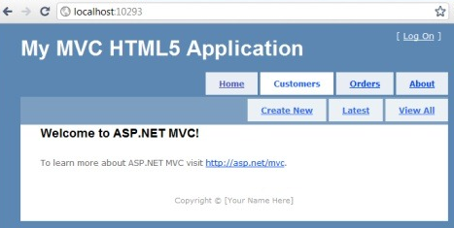
Example
Suppose you have a global menu to render in a number of views.
Each view may have a number of ways to interact with the user, and the user may take a number of actions in relation to your application.
Whatever the interaction and subsequent output, the menu has to be rendered.
This means that the controller method that, say, uploads a news item must be informed about the details of the menu and where the items are to be retrieved.
It's clearly too much of a responsibility for a NewsController class, isn't it?

Slide 68
Menu Render Action
public class MenuController : Controller
{
[ChildActionOnly]
public ActionResult List()
{
var model = new MenuViewModel();
model.MenuItems.Add(new MenuItem()
{
ActionName = "index",
ControllerName = "Home",
LinkText = "Home"
});
model.MenuItems.Add(new MenuItem()
{
ActionName = "about",
ControllerName = "Home",
LinkText = "About us"
});
return PartialView("_Menu", model);
}
}

Slide 69
Invoking Menu Render Action
<div id="menucontainer">
@Html.Action("list", "menu")
</div>
<div id="menucontainer">
@ { Html.RenderAction("list", "menu"); }
</div
The method Html.Action returns the markup as a string, whereas RenderAction writes directly to the output stream.

Slide 70
Passing Data to a Render Method

Slide 72
Restricting Access to Action Methods
How would you mark an ASP.NET MVC URL (for example, a controller method) to require authentication?
[Authorize]
public ActionResult Index()
{
...
}
[Authorize]
public class HomeController
{
public ActionResult Index() { … }
...
}

Slide 73
Handling Authorization for Action Methods
If a user is not authenticated or doesn’t have the required user name and role, the attribute prevents access to the method and the user is redirected to the logon URL.
Weakness: The attribute doesn’t ultimately distinguish between users who are not logged on and those who are but who do not have the rights to invoke a given action method.
In both cases, in fact, the attempt to call the action method redirects the user to the logon page.
[Authorize(Roles="admin", Users="DinoE, FrancescoE")]
public ActionResult Index() { ... }

Slide 74
Extending the Built-in Authorize Attribute
public class AuthorizedOnlyAttribute : System.Web.Mvc.AuthorizeAttribute{
public AuthorizedOnlyAttribute(){
View = "error";
Master = String.Empty;
}
public String View { get; set; }
public String Master { get; set; }
public override void OnAuthorization(AuthorizationContext filterContext){
base.OnAuthorization(filterContext);
CheckIfUserIsAuthenticated(filterContext);
}
private void CheckIfUserIsAuthenticated(AuthorizationContext filterContext){
// If Result is null, we're OK: the user is authenticated and authorized.
if (filterContext.Result == null) return;
// If here, you're getting an HTTP 401 status code
if (filterContext.HttpContext.User.Identity.IsAuthenticated){
if (String.IsNullOrEmpty(View)) return;
var result = new ViewResult {ViewName = View, MasterName = Master };
filterContext.Result = result;
}
}
}

Slide 75
Using Extended Authorize Attribute
[AuthorizedOnly(Roles="admin", Users="DinoE")]
public ActionResult Index()
{
...
}

Slide 77
ASP.NET MVC Areas
http://msdn.microsoft.com/library/ee307987

Slide 78
nopCommerce
http://www.nopcommerce.com/
nopCommerce is an open source ecommerce software that contains both a catalog frontend and an administration tool backend.
nopCommerce is a fully customizable shopping cart.
nopCommerce is an open source ecommerce solution that is ASP.NET (MVC) based with a MS SQL 2008 (or higher) backend database.

Slide 79

Thank You for Your Time

